Slide 1
Trees
Lecture 9
Discrete Mathematical Structures

Slide 2
At the Last Class …
Finite Boolean Algebra
  Boolean algebra: a special type of lattice
  Substitution rule for Boolean algebra
Logical Design
  Boolean expressions
  Circuit Design

Slide 3
Trees
Part I: Rooted Trees
  Basic properties of rooted tree
  Labeled tree and its representation
  Tree searching
Part II: Undirected Trees
  Undirected graph: as a symmetric closure
  Basic properties of undirected tree
  Minimal spanning tree and its algorithm

Slide 4
Rooted Tree
Let A be a set, and let T be a relation on A. T is a rooted tree if there is a vertex v₀ in A with the property that there exists a unique path in T from v₀ to every other vertex in A, but no path from v₀ to v₀.
v₀

Slide 5



Properties of Rooted Tree
Let (T, v₀) be a rooted tree. Then
  (a) There are no cycles in T.
  (b) v₀ is the only root of T.
  (c) Each vertex other than the root has in-degree one, and the root has in-degree 0
v₀
v₀
v₀
?
More than one path from v₀ to v.
p
A cycle
from v₀ to v’₀
v
v_{k}
More path to w₁
?
c
v₀’
w₁
(a)
(b)
(c)

Slide 6
Drawing a Rooted Tree by Levels
All edges downward
Level 0
Root
Inner node
Leaf
Level 1
Branching node
Height=3
Level 2
Level 3

Slide 7
Rooted Tree and Family Relations
It is easy to describe the family relations，and on the other hand, terms about family relations are used in rooted trees.
John's ancestors
John's parent
John’s siblings
John
John's child
John's descendants

Slide 8
Some Terms about Rooted Tree
Ordered tree: the ordering is assumed on vertices in each level;
n-tree: every vertex has at most n offspring;
Complete n-tree: every vertex, other than leaves, has exactly n offspring
Binary tree: 2-tree

Slide 9
Subtree of a Rooted Tree
If (T,v₀) is a rooted tree and v∈T. Let T(v) be the set of v and all its descendants, then T(v) and all edges with their two ends in T(v) is a tree, with v as its root.
(It is called a subtree of (T,v₀) )
Proof:
  There is a path from v to any other vertex in T(v) since they are all the descendants of v;
  There cannot be more than one path from v to any other vertex w in T(v) , otherwise, in (T,v₀), there are more than one path from v₀ to w, both through v
  There cannot be any cycle in T(v), since any cycle in T(v) is also in (T,v₀)

Slide 10
Subtrees of Binary Tree
In a ordered binary tree, a subtree is a left subtree or a right subtree.
Even if a vertex has only
one offspring, its subtree can
be identified as left or right
by its location in the digraph.
Left subtree
Right subtree

Slide 11
Ordered Binary Tree
Any ordered tree can be converted into a ordered binary tree.

Slide 12
Labeled Tree: an Example
Using rooted tree to represent a arithmetic expressions:
  branching vertices corresponding operators
  leaves corresponding operands
/
+
+
Example:
(a*(b+c)+d*(e*f))/(g+(h-i)*j)
g
*
*
*
a
+
d
-
j
b
c
e
i
f
h

Slide 13

Positional Trees
Positional Binary Tree
L
R
2
3
3
R
R
2
L
1
3
L
R
1
2
3
L
L
3
R
R
1
R
L
2
L
R
L

Slide 14
Computer Representation
3 arrays:
LEFT DATA RIGHT
(3-(2×x))+((x-2)-(3+x))
as a doubly linked list
S
1
8
12
14
+
-
+
x
2
13
3
5
7
9
3
-
×
x
-
2
11
6
3
2
10
x
4

Slide 15
Tree Searching
Tree recursive algorithm to search all vertices:
  Inorder: left, root, right
    h, d, i, b, e, a, f, c, g
  Preorder: root, left, right
    a, b, d, h, i, e, c, f, g
  Post order: left, right, root
    h, i, d, e, b, f, g, c, a
a
b
c
d
g
e
f
h
i

Slide 16
Reverse Polish Notation
Example: (a*(b+c)+d*(e*f))/(g+(h-i)*j)
Searching in postorder:
abc+*def**+ghi-j*+/
It is called reverse
Polish notation
/
+
+
*
*
g
*
a
+
d
-
j
b
c
e
i
f
h
No parenthesis are needed!

Slide 17
Huffman Code Tree
0
1
0
1
0
1
0
1
E
0
1
0
1
01
10
11
000
0
1
A
0
1
0010
0011
E: 0
A: 10
S: 110
R: 1110
C: 1111
S
0
1
C
R
0101100: EASE

Slide 18
Undirected Tree
An undirected tree is the symmetric closure of a tree.
An undirected tree is represented by its graph, which has a single line without arrows connecting vertices a and b.
The set {a,b}, where (a,b) and (b,a) are in T, is called an undirected edge, and a and b are called adjacent vertices.

Slide 19
Undirected Tree: Examples
Different undirected trees with six vertices:
Symmetric closure

Slide 20
Path and Cycle in a Tree
Let p: v₁,v₂,...,v_{n} be path in a symmetric relation R, then p is simple if no two edges of p correspond to the same undirected edge.
In above, if v₁ is equal to v_{n} , then p is a simple cycle.
A symmetric relation R is acyclic if it contains no simple cycles.
A symmetric relation R is connected if there is a path in R from any vertex to any other vertex.

Slide 21
Properties of an Undirected Tree
Let R be a symmetric relation on a set A. R is an undirected tree if and only if R is connected and acyclic.
  Proof:
  ⇒ Let R is the symmetric closure of some tree T.
    Suppose that R has a simple cycle p: v₁,v₂,...,v_{n}, v₁. Then there is a figure of edges as the following in T. However, all possible orientation of the edges results a cycle in T.
Note: the following orientation is impossible in a tree:

Slide 22
Properties of an Undirected Tree (cont.)
  Proof:
  ⇒ (cont.)
    Let v is the root of T. For any vertices u and w, there must be vu-path and vw-path in T, so, there are uv-path and vw-path in R. So, there is a uv-path in R.
  ⇐ Suppose that R is a symmetric relation on a set A, and it is connected and acyclic
    Let v is any vertex in A. Since R is connected, there is a path from v to any other vertices, but not to v itself.
    Suppose that there are two paths from v to some w. There must be two vertices v’, w’, on both paths such that there are no common vertices on two different v’w’-path, since R is symmetric, one v’w’-path and the reverse of another v’w’-path form a cycle in R, contradiction.

Slide 23
Unique Path
If T is an undirected tree, then for any vertices u, v, there is a unique uv-path in T.
  Proof:
  We know that T is connected, so, there is at least one uv-path in T.
  Suppose that there are two different uv-paths P,Q in T. Without loss of generality, there exists an edge e=(x,y) satisfying e∈P, and x is nearer to u on P than y, but e∉Q. Let T*=T-{e}, then T* contains Q. Note that xu-segment on P +Q+vy-segment on P is an xy-path in T*. However, this path plus e is a cycle in T. Contradiction.

Slide 24
No Edge Can Be Removed
Let T is an undirected tree, e is any edge in T, then T-{e} is no longer connected.
  Proof:
  We have know that for any vertices v,w, there is a unique vw-path. Let e=(x,y), then e is the unique path between x and y. So, there is no xy-path in T-{e}, which means that T-{e} is no longer connected.

Slide 25
Adding One Edge Means Cycle
Let T is an undirected tree, u,v are two vertices not adjecent to each other, then T+(u,v) must contain a cycle.
  Proof:
  Since T is a undirected tree, there must be a uv-path in T. Let it be P, then P+(u,v) is a cycle in T+(u,v).
  In fact, we can prove that there is only one cycle in T+(u,v).

Slide 26
Number of Vertices and Edges
A tree with n vertices has n-1 edges
Proof:
  There are at least n-1 edges to connect n vertices.
  Suppose that there are more than n-1 edges. So, the sum of in-degree of all vertices must be more than n-1. However, the in-degree of the root is zero, and in-degree of any of the other n-1 vertices is 1, which mean the sum is n-1. Contradiction.

Slide 27
Spanning Tree
If R is a symmetric, connected relation on A, a tree T on A is a spanning tree of R if T is a tree with exactly the same vertices as R.
An undirected spanning tree is the symmetric closure of a spanning tree.
Note that an undirected spanning tree can always obtained by remove some edges from a symmetric, connected relation R.

Slide 28
Spanning Tree: Examples
Different spanning tree are obtained from a symmetric, connected relatioin:
Breadth first
Breaking cycles
Depth first

Slide 29
Generic Algorithm for MST Problem
Input: G: a connected, undirected graph
w: a function from V_{G} to the set of real number
Generic-MST(G,w)
1 A←0
2 while A does not form a spanning tree
3 do find an edge (u,v) that is safe for A
4 A←A∪{(u,v)}
5 return A
Output: a minimal spanning tree of G

Slide 30

Prim’s Algorithm for MST
B
Step 1: V={A}, E={}
Step 2: Select the nearest
neighbor of V, u, add the
edge connecting u and
some vertex in V into E
Step 3: Repeat step 2 until E
contains n-1 edges
End of Algorithm
26(9)
27
21(4)
A
C
42
E
36
34
25(1)
29
D
22
33
I
16(7)
18(2)
21(8)
H
21(5)
J
25(6)
F
28
17(3)
53
G

Slide 31
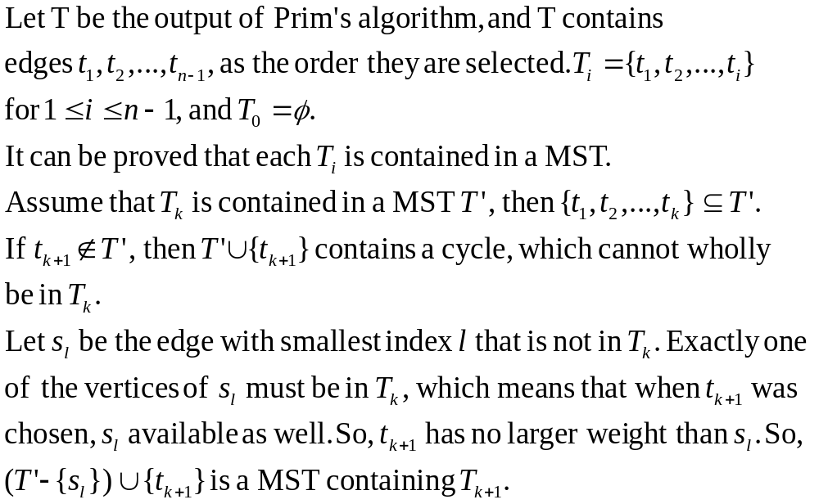
Correctness of Prim’s Algorithm
s₁
s_{l}
t_{k+1}
s_{r}
s_{r-1}

Slide 32
Kruskal’s Algorithm for MST
B
Step 1: E={}
Step 2: Select the edge with
the least weight, and not
making a cycle with
members of E
Step 3: Repeat step 2 until E
contains n-1 edges
End of Algorithm
26(9)
27
21(4)
A
C
42
E
36
34
25(8)
29
D
22
33
I
16(1)
18(3)
21(7)
H
21(6)
25(9)
F
J
28
17(2)
53
G

Slide 33
Proof of Kruskal Algorithm
Obviously, T is an undirected tree.
Suppose that T is not minimal. According to the ordering of adding edges in T, T contains edges e₁,e₂,…e_{k-1},e_{k},…e_{n-1}. Let T’ is a minimal spanning tree which has most consecutive common edges from the beginning with T. And let e_{k} is the first edge not in T’. So, T‘+e_{k} contains a cycle, let e_{k}‘ is on the cycle, but not in T, then T*=T'-{e_{k'}}⋃{e_{k}} is also a spanning tree, and we have w(T*)=w(T')-w(e_{k'})+w(e_{k}). According to the criteria to select the edges, w(e_{k'})≥w(e_{k})，∴w(T*)≤w(T'), which means that T* is also a minimal spanning tree, and with more common consecutive edges with T. Contradiction.

Slide 34
Kruskal Algorithm - Implementation
KRUSKAL(V,E,n)
<sort E by nondecreasing weight>;
for each v∈V do MAKESET({v}) end for;
T={};
while |T|<n-1 do
<check the next edge (x,y) in E>;
if FIND(x)≠FIND(y) then
T=T∪{(x,y)};
UNION(x,y);
end if
end while
return T;
O(mlogm)
Θ(n)
Θ(n)
O(mlog*n)
n-1 UNION’s and 2m FIND’s at most
The algorithm finishs in O(mlogm) time.
Or, O(n²logn); O(nlogn) for planar graph.

Slide 35
Home Assignments
To be checked
  pp.258: 18-22, 24,29, 32-34
  pp.263: 7, 13,18, 25-27
  pp.271: 10, 15, 19-22, 25, 33, 37-38
  pp.278: 16-17, 19, 21, 26
  pp.285: 6, 9, 11, 14, 18, 23
Self tests

